Slide 1

Theft of Intellectual Property

Slide 2


Team Roles
Sangey Lama
Information Security Officer (ISO)
Resha Ramcharan
IT Risk Analyst
Raj Rana
IT Risk Analyst
Dylan Rambarran
Cyber Threat Analyst
Grissel Lopez
Behavioral Analyst
Danny Mancheno
Behavioral Analyst
Fizza Khan
Compliance Analyst
Amose Ho
Compliance Analyst

Slide 3
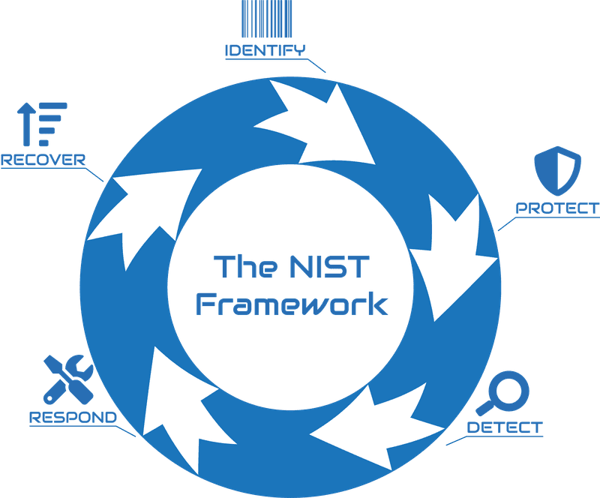
NIST Cybersecurity Framework

Slide 4
Identify
Root cause of problem:
Why did it happen?
◦ It is easy to look only at what is in front of you. We must look deeper.
◦ The competitive advantage of the firm is lost to another, this can conclude that
The motive may have been theft for competitive advantage between the firms.
◦ Pangang is a state backed company by China, we can conclude that the motive
could have been to become more nationally competitive.
◦ Undoubtedly a money reward may have been a large contributor. The figure is
unknown. But the damages are.
Danny

Slide 5
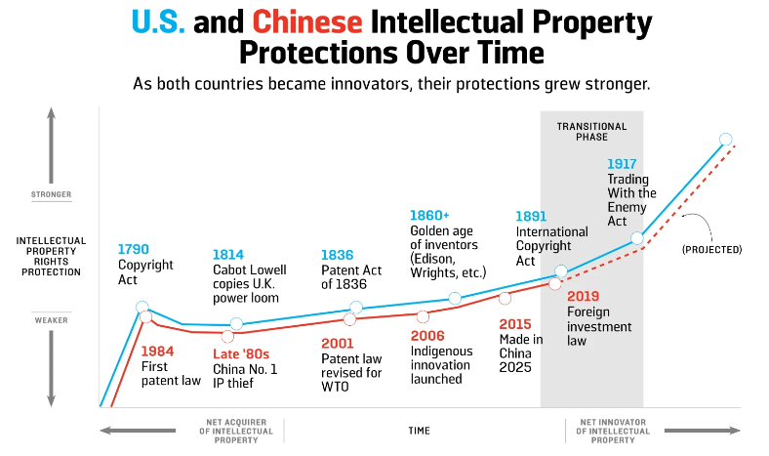
Identify
Source: https://foreignpolicy.com/2019/10/16/china-intellectual-property-theft-progress/
Danny

Slide 6
Identify
• Weak law enforcement
◦ China will not adhere to US demands. It can simply deny charges.
◦ It is impossible to fully monitor a person’s actions or behavior without
bringing us to a monitoring dystopia. Rights will decrease over time.
◦ Because the point to which we can eliminate IP theft will cost too much.
The root problem is likely too complex to fully eliminate. But we can try.
◦ China’s intellectual protection laws and their enforcement need to catch
up to the United States.
Danny

Slide 7
Root cause of problem?
• The combination.
◦ Weak law enforcement. Monetary, nationalistic or Competitive benefits are may
Have all been causes but the extent of each is unknown.
◦ Because of the current impossibility to enforce protections from china. The
Landscape leaves cracks for theft behaviors.
◦ Hundreds of billions of dollars in Intellectual property damages happen yearly.
We’re one of many affected.
◦ Until China can see eye to eye with US, mitigation! See: Recommendations
Danny

Slide 8

What are some findings?
Theft of intellectual property involves the stealing of ideas, inventions, and creative expressions. In this case the threat actor stole the design and code of a US financial service company.
Theft of the U.S.’ intellectual property costs the U.S between $180 billion and $540 billion annually. China is responsible for a large amount of this range. This shows that the thief in this case is a huge part of these estimates, as it states that his financial impact was estimated in the billions as well.
One way that people can steal intellectual property is through access exploitation, which is when an employee uses their inside access to provide outside people with information. The thief in this case used his position in the company to help Pangang.
Dylan Rambarran

Slide 9

Identify
Who was the threat-actor?
Walter Liew, a development manager who had spent 15 years with the US financial services Company. He used his position to steal design and code, to help China’s state owned Pangang company.
Grissel Lopez

Slide 10

Identify
What caused it to happen?
Walter Liew was motivated by money, the Pangang company made multi-million dollar deals to steal the technology. Although Walter had been on the job for 15 years, he did not feel like a valued employee and felt undercompensated.
Grissel Lopez

Slide 11
Protect
How do you prioritize what to do first?
○ Gather all the evidence through activity logs and employees/vendors emails to identify possible culprits.
○ Evaluate the level of damage and find ways to minimize it.
○ Freeze all the vendor account immediately for a time period, before the potential threat has been identified
Resha Ramcharan

Slide 12

Protect
What controls / security measures should be implemented to prevent a repeat?
● Copyrights and Patents
● A rigorous vetting process
● Access only on a need-to-know basis.
● Company-wide email monitoring
● Track system login activities
Raj Rana

Slide 13

Detect
What laws are in place to convict the threat actor?
The Computer Fraud and Abuse Act (CFFA)
Walter Lian-Heen Liew worked with a US financial services company for 15
years, and decided to steal the company data with attempts to gain profits and help China’s state-owned Pangang.
His crimes include the violation of Economic Espionage, tax evasion, bankruptcy law, and obstruction of justice. These crimes overlap with the offense in, The Computer Fraud and Abuse Act (CFFA) and Economic Espionage Act.
Accessing a computer to obtain valuable information
from a computer through unauthorized access and multiple convictions
led Walter to be sentenced in prison for 15 years.
Sangey

Slide 14

Respond
Who do you report the incident to?
The incident should be reported to local field offices of federal law enforcement agencies such as:
The Federal Bureau of Investigation
National Cyber Investigative Joint Task Force.
Sangey

Slide 15

How to communicate? (Internal)
Explain the details and consequences of the incident that has occurred through a detailed email.
Build trust and engage leadership with the business. A few steps that are critical to take in order to communicate are:
Contact the business units
Explain the attack in detail
Highlight the efforts that the company is making in order to handle the situation
Talk about the possible ways to prevent future attacks.
Respond
Fizza
Notes:
Fizza Khan - Compliance Analyst

Slide 16

Respond
What to communicate?
Since the person who helped steal the design and code was the development manager who spent 15 years with the US Company. It is important to:
Avoid notifying all employees until the matter is resolved
Limit employee access to data and information
Only the department Heads and Executives must receive detailed information on the attack such as:
The reason and cause of the attack
The consequences of the attack on the company
Ways to control the damage that is caused by the attack and how the company is working on methods to regulate it.
How to prevent similar attacks in the future.
Fizza
Notes:
Fizza Khan - Compliance Analyst

Slide 17

Respond
What to communicate? (public)
Message to be conveyed to the public
What the attack was and how it affected the business
What measures have been taken and
assurance of prevention in regards to future incidents
Timeline of recovery process
Lasting damage to company and/or customers
and possible compensation routes (concisely)
What to avoid while addressing the public
Avoid including industry jargon while maintaining central focus of message
Minimize inclusion of information that might cause panic
Delaying the response
Amose

Slide 18

Recover
How do you recover from it?
Implement essential policies in order to recover the stolen data
Limited access to critical infrastructures
Implement a training program to educate employees and vendors
Conduct exit interviews to detect threat
Periodical evaluation of the risk associated with various vendors
Switch to cloud-based applications and file services that are managed by the company

Slide 19


Slide 20

THANK
YOU!

